Slide 1


FiberViewer Light
Tutorial
Berger Jean-Baptiste
jean-baptiste.berger@cpe.fr

Slide 2

Index
Getting Started - - - - - - - - - - - - - - - - - - - - - - - - - - - - - - - - - - - - - - - - - 3
Clustering - - - - - - - - - - - - - - - - - - - - - - - - - - - - - - - - - - - - - - - - - - - - 4
Length Method - - - - - - - - - - - - - - - - - - - - - - - - - - - - - - - - - - - 5
Gravity, Hausdorff and Mean Methods - - - - - - - - - - - - - - - - - - - - 7
Cluster Selector - - - - - - - - - - - - - - - - - - - - - - - - - - - - - - - - - - 9
Normalized Cut - - - - - - - - - - - - - - - - - - - - - - - - - - - - - - - - - 11
Saving your VTK File - - - - - - - - - - - - - - - - - - - - - - - - - - - - - - - 12
Visualisation - - - - - - - - - - - - - - - - - - - - - - - - - - - - - - - - - - - - - - - - - - 13
Plane Settings - - - - - - - - - - - - - - - - - - - - - - - - - - - - - - - - - - - 14
General visualisation controls - - - - - - - - - - - - - - - - - - - - - - - - - 16
Contributors - - - - - - - - - - - - - - - - - - - - - - - - - - - - - - - - - - - - - - - - - - 17

Slide 3
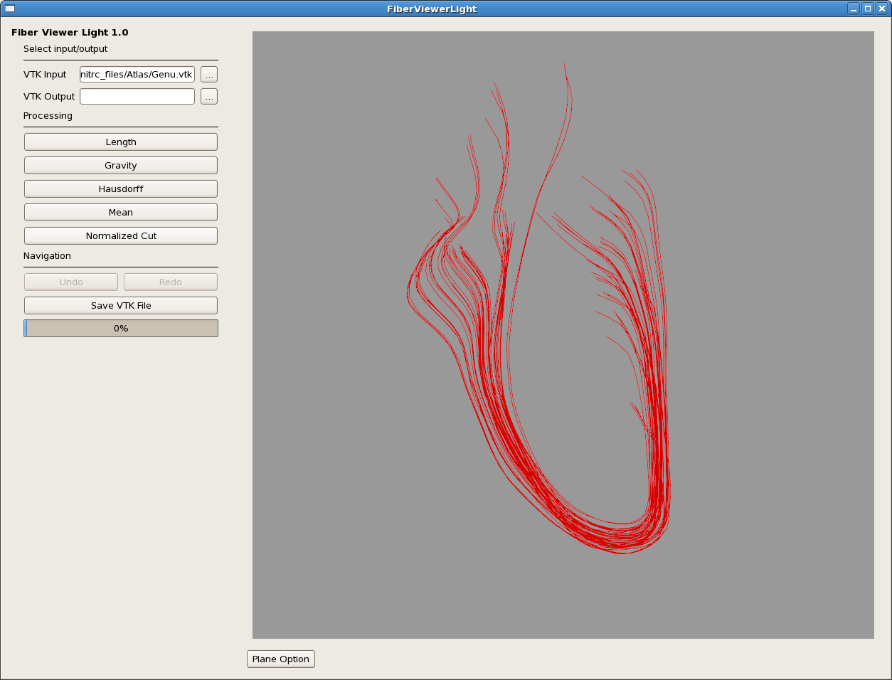
Getting Started
From GUI :
  Select a VTK Input File
  Choose the Clustering Method
From Command Line :
./FiberViewerLight -i input_name -o output_name

Slide 4
Clustering

Slide 5
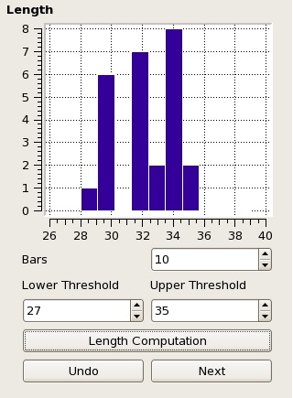
Length Method
Fiber extremities is Threshold default values
Bars option is the number of bars that will be used on the histogram if none of the fibers were thresholded
Click on Apply Threshold to display the thresholded fiber
Click Next or Undo to go back to the main screen, Next will keep changes

Slide 6
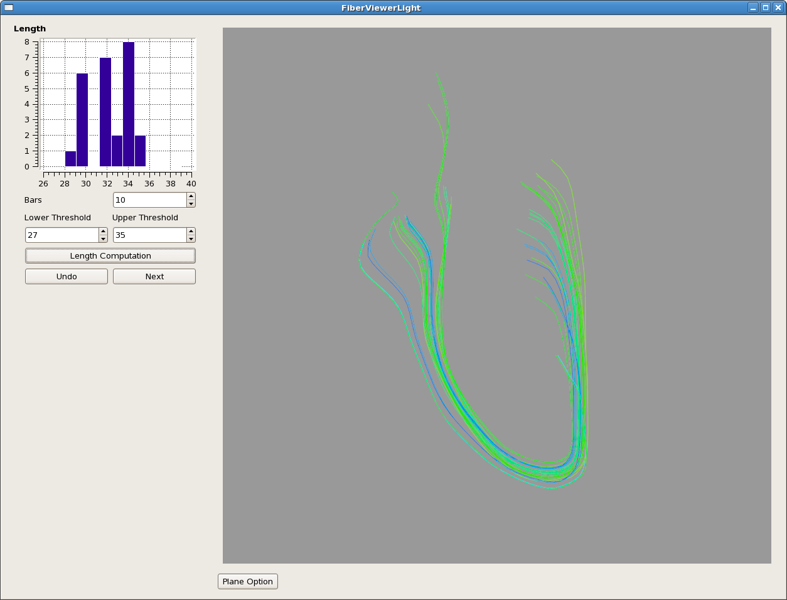
Length Method
Colors go from blue (shortest) to red (longest)

Slide 7
Gravity, Hausdorff and Mean Methods
Same general approach for each method
Algorithm based on gravity, Hausdorff or mean pairwise distance matrix :
  Distance between each center of gravity
  Maximum of pair wise distances of two fibers
  Mean of pair wise distances between two fibers

Slide 8
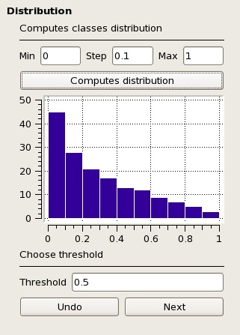
Gravity, Hausdorff and Mean Methods
Clicking on “Compute Distribution” will generate histogram
There will be (Max – Min)/Step bars from Min to Max
Click on Next to display generated classes with Threshold value parameter

Slide 9
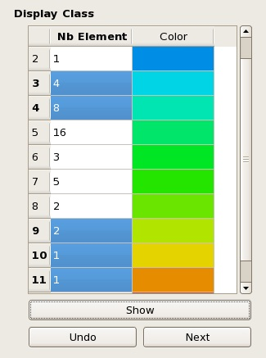
Cluster Selector
Structure of the table : Number of elements of Idth class and associated color
Click on the number of elements to select class
Click again to deselect a class

Slide 10
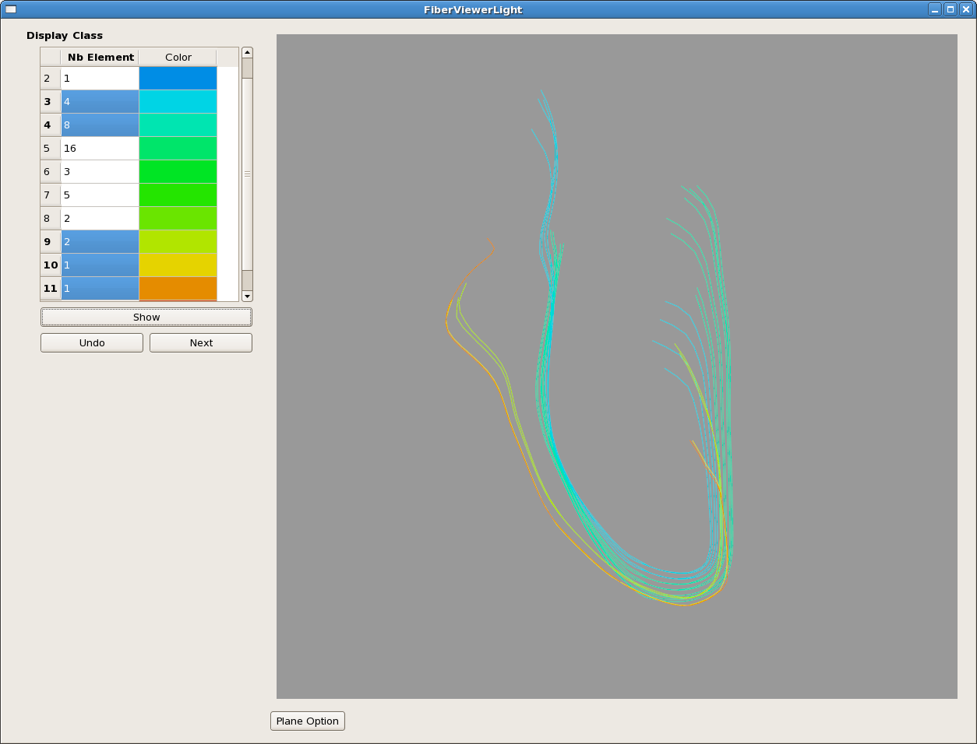
Cluster Selector
Click on “Show” to display selected clusters only
“Undo” to go back to the Distribution panel
“Next” to keep changes and go back to main menu

Slide 11
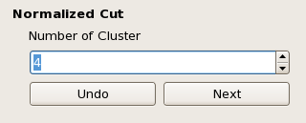
Normalized Cut
Choose the number of cluster which will be the number of classes
Pairwise mean distance based algorithm

Slide 12
Saving your VTK File
When you are done :
  Enter a VTK Filename on the main menu
  Or
  Click on “Save VTK” on the main menu and it will open a browser.
If there is a VTK Filename specified on the main menu, each time you will click on “Save VTK”, it will update the VTK output file

Slide 13
Visualization

Slide 14
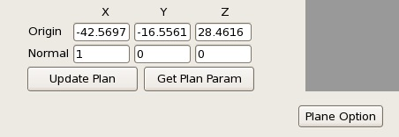
Plane Settings
Display a plane by clicking on Plane Option button
Default display : Center of gravity
Change origin and normal settings and update thanks to the corresponding button
Retrieve coordinates by clicking “Get Plan Param” button

Slide 15
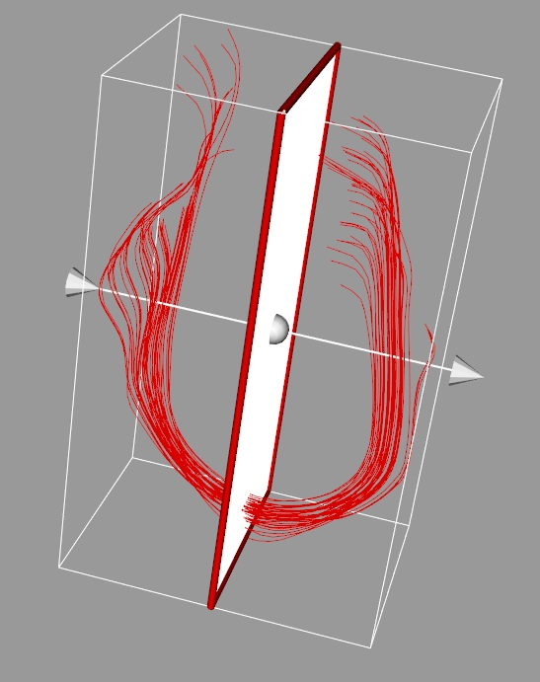
Plane Settings
Translate the plan by dragging it
Rotate the plan by dragging the normal arrow

Slide 16
General Visualization Controls
Drag to rotate the view
Shift + Drag to translate the fiber
Ctrl + Drag to rotate on the perpendicular axe to the screen
Right dragging or wheel to zoom in or out

Slide 17
Contributors
Jean-Baptiste Berger :
  jean-baptiste.berger@cpe.fr
Clement Vachet :
cvachet@unc.edu
Martin Styner :
martin_styner@ieee.org

